Slide 1



422 Final Project
Credit Card Transaction
Fraud Detection
Group 3: Zeyang Yu, Ziqi Lin, Pengyu Zhao, Lijia Yu

Slide 2


Agenda
Research Question & EDA
Processing Features
Methodology
Results
Recommendation and Conclusions

Slide 3


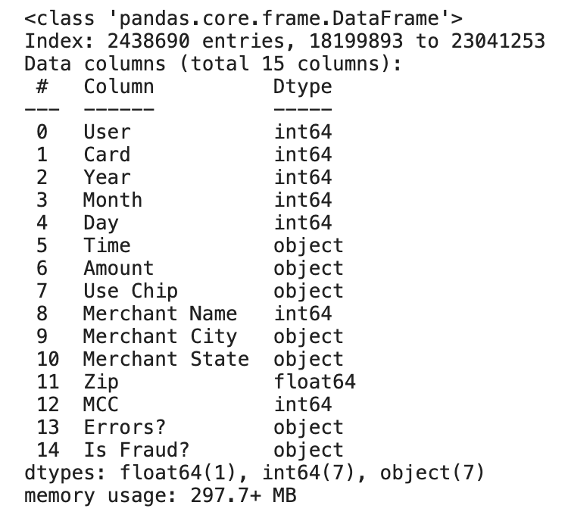
1.1 Research Question
How can we effectively build and evaluate machine learning models to detect fraudulent transactions in credit card data?
1.2 Dataset Background
The dataset is a synthetic credit card transaction dataset created by IBM， designed for fraud detection model training purposes. It represents over 20 million transactions from fictional consumers in the United States over several decades.

Slide 4

1.3 EDA
Data Cleaning

Slide 5
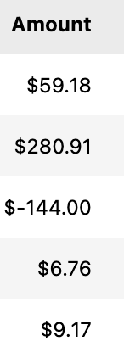
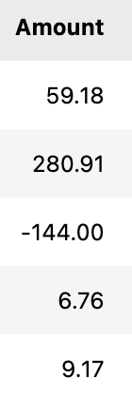
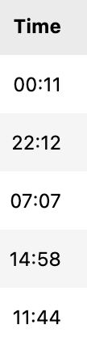
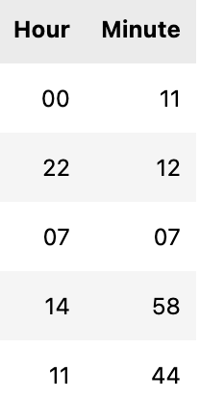
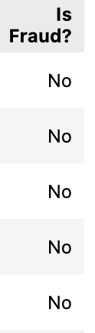
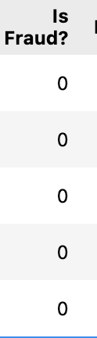
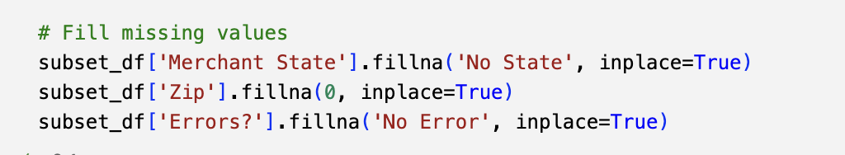
Data Cleaning
1. Strip the '$' from the Amount
2. Create hour and minute variables by extracting from 'Time'
3. Change categorical variable to binary variable
4. Handle missing value
1
2
3
4

Slide 6

1.4 EDA
Visualization

Slide 7
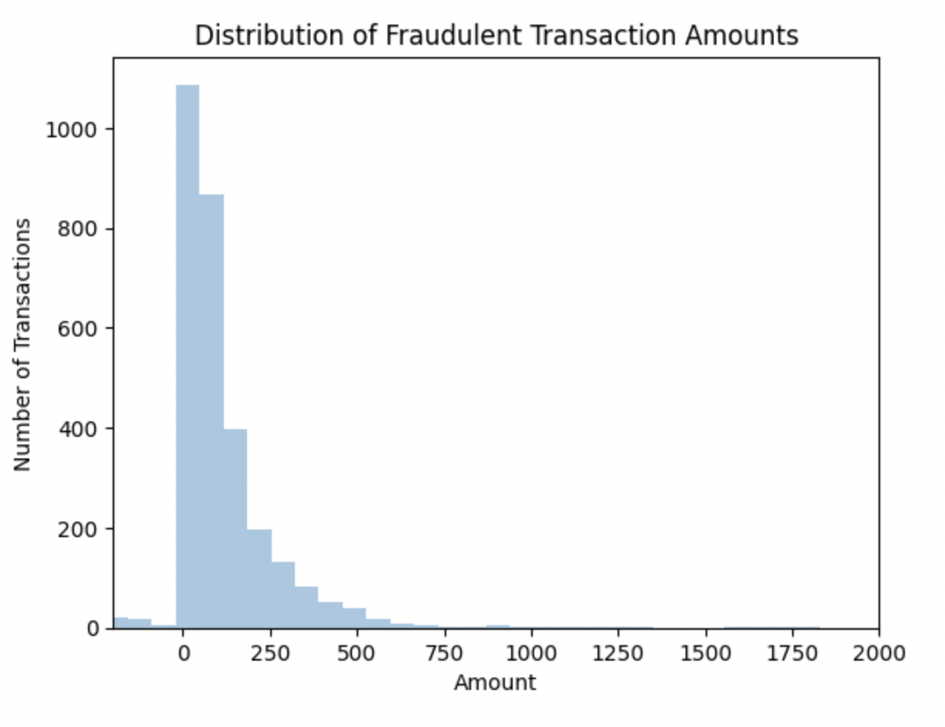
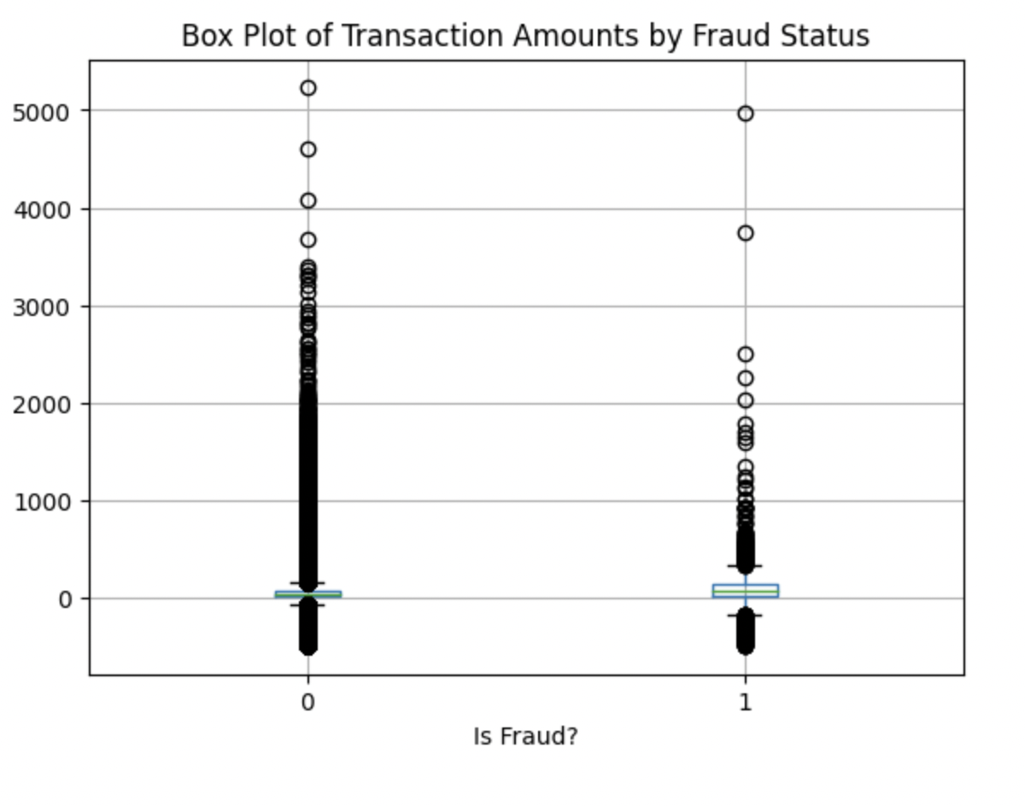

Transaction Amounts Distribution, Box Plot
Majority of fraudulent transactions occur at lower amounts.
The frequency of fraud decreases as the transaction amount increases.
Legitimate transactions have a lower median amount than fraudulent transactions.
Non-fraudulent transactions show more variability and have many high-value outliers.
Notes:
We want to know the amount of the transaction that is most likely to be fraudulent
Large transaction amounts are most likely to fraud

Slide 8
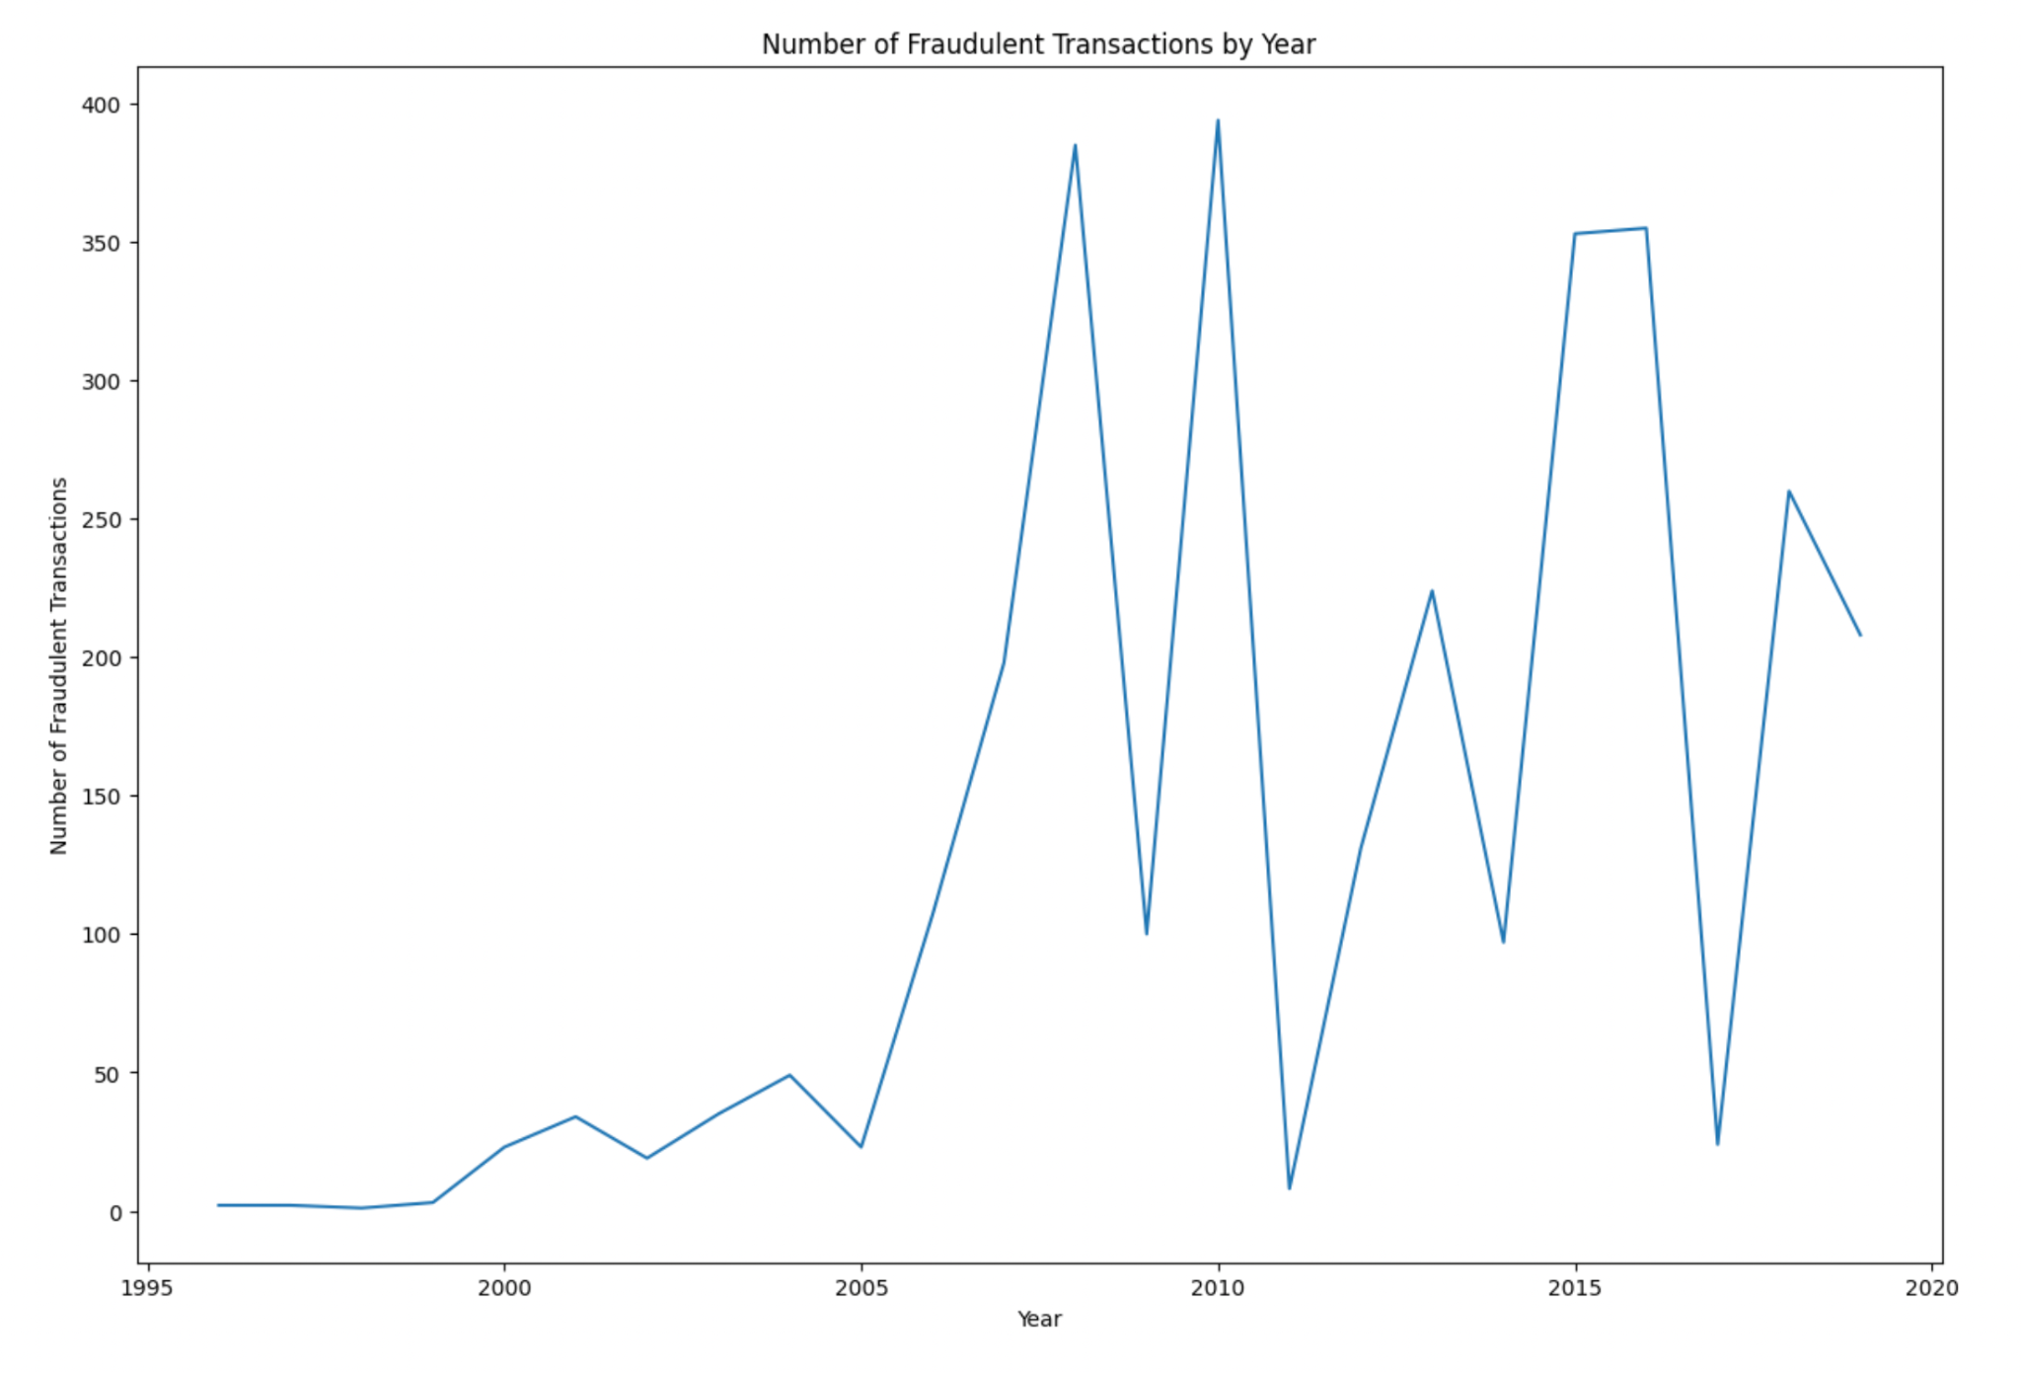
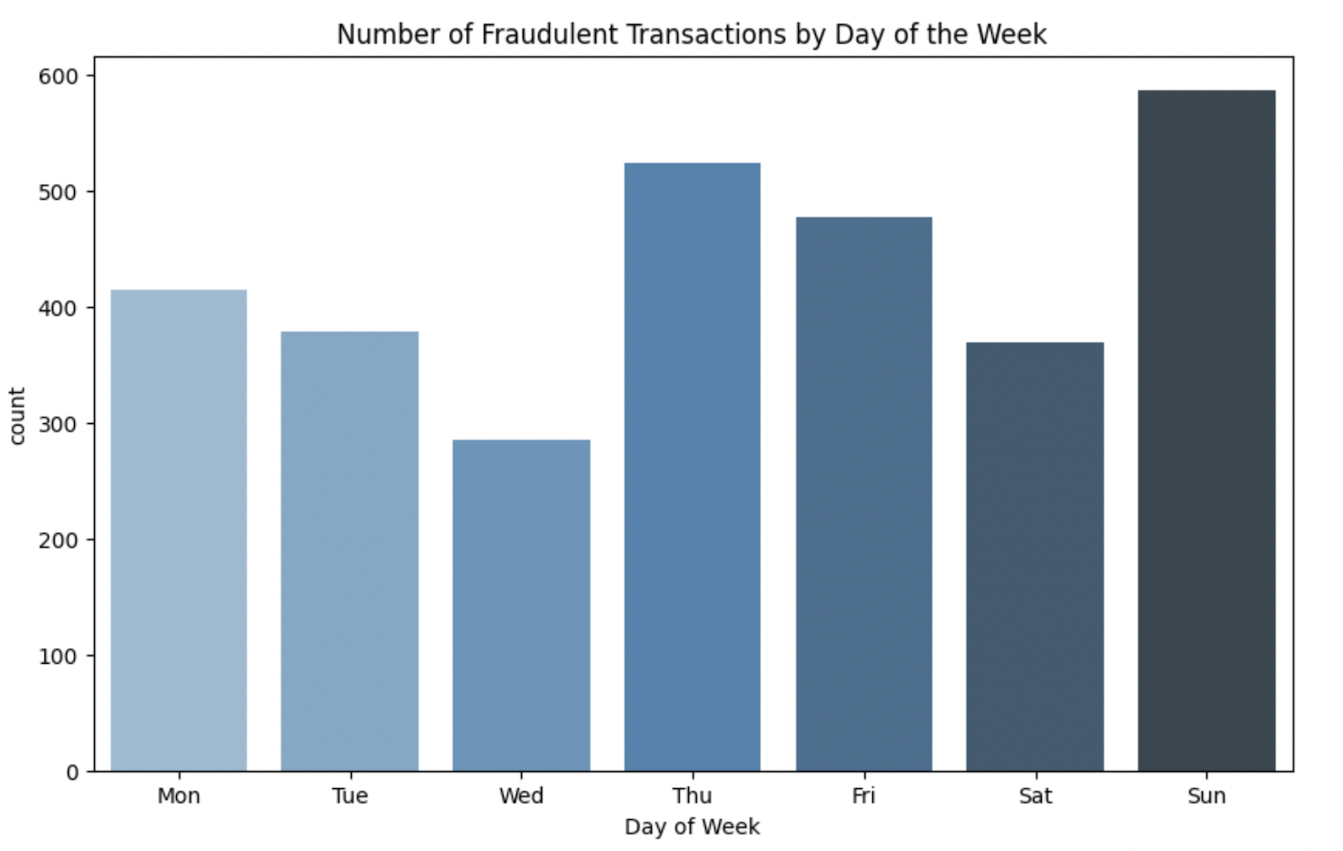
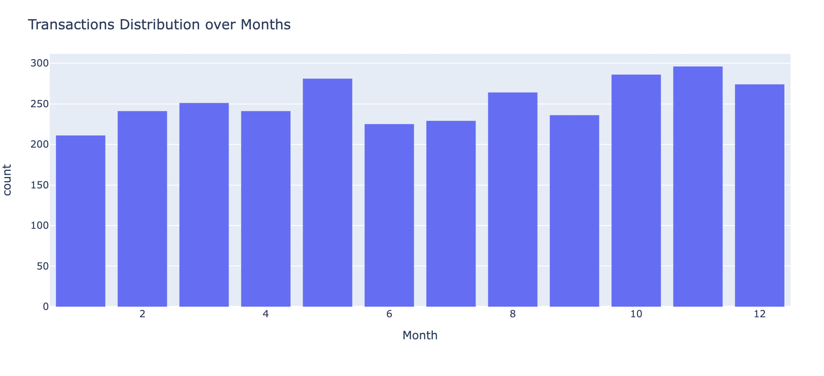
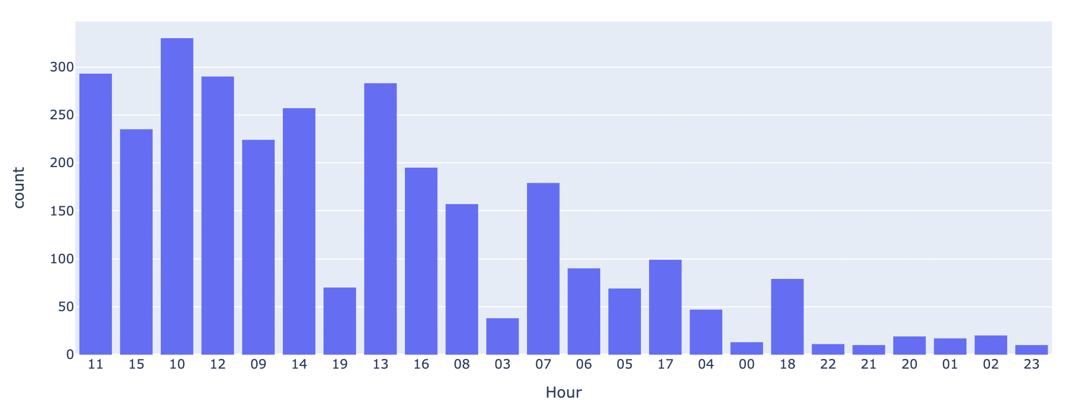
Time - by years, day of week, months, hours

Slide 9

2. Data Processing

Slide 10
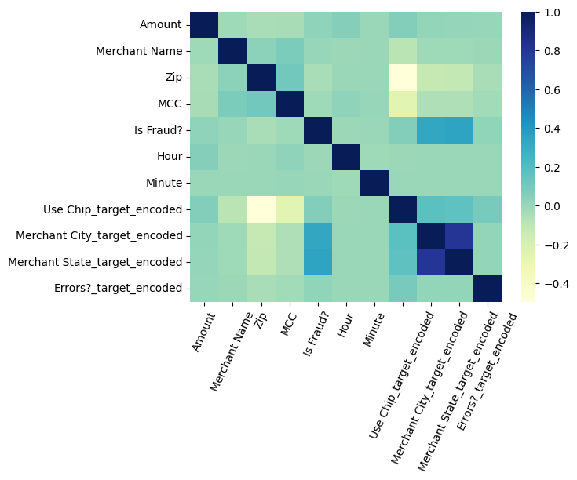
Data Processing
Is Fraud? | Before SMOTE | After SMOTE
0 | 2,435,655 | 2,435,655
1 | 3,035 | 2,435,655
Subset Selection
Randomly select 2 million transactions (10%)
Feature Engineering
Drop features
Categorical feature transformation
SMOTE
Training and testing split: 80/20
Standard Scaling
Scale numeric features

Slide 11

3. Methodology

Slide 12
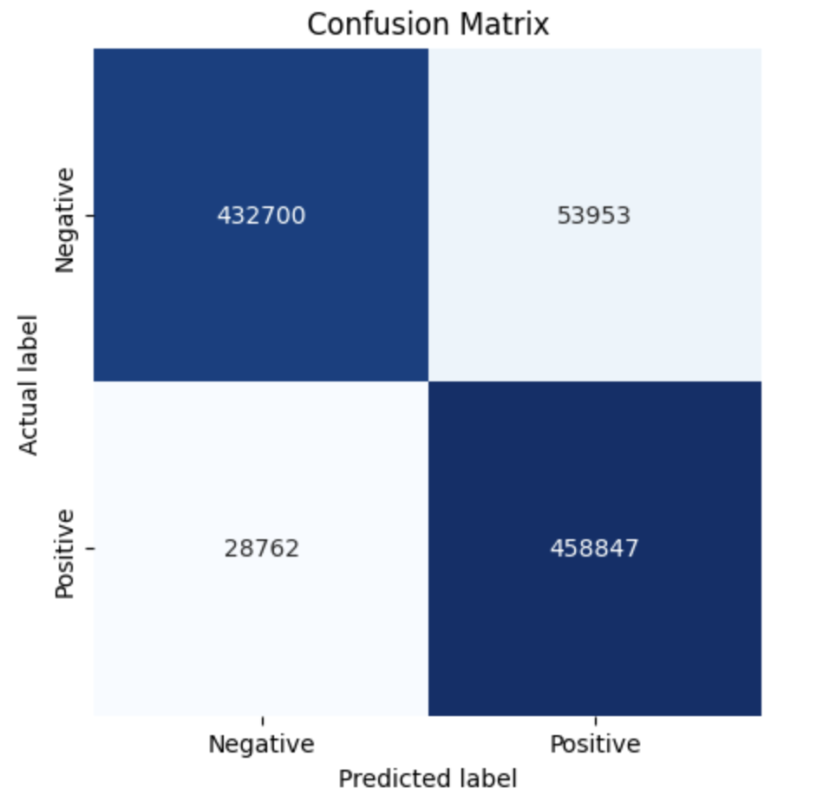
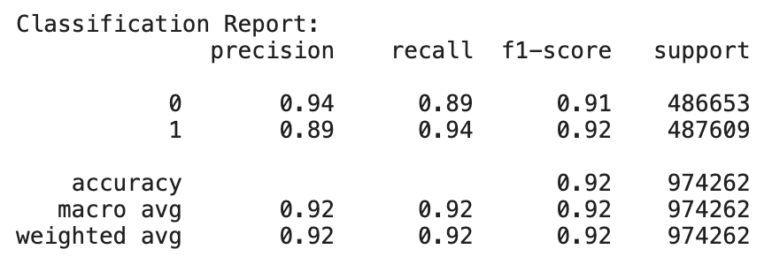
3.1 Logistic Regression
Short Training Time
Accuracy: 0.92 - The overall accuracy indicates that 92% of the transactions were correctly classified by our model.
Macro Average F1-Score: 0.92 - This suggests a balanced performance across both classes, without bias toward the majority class.
Notes:
logistic regression model demonstrates strong performance in identifying both fraudulent and legitimate transactions within this extensive dataset. The high F1-scores for both classes suggest that the model has achieved a good balance between precision and recall, making it reliable for both detecting fraud and minimizing the number of legitimate transactions incorrectly flagged as fraudulent.

Slide 13
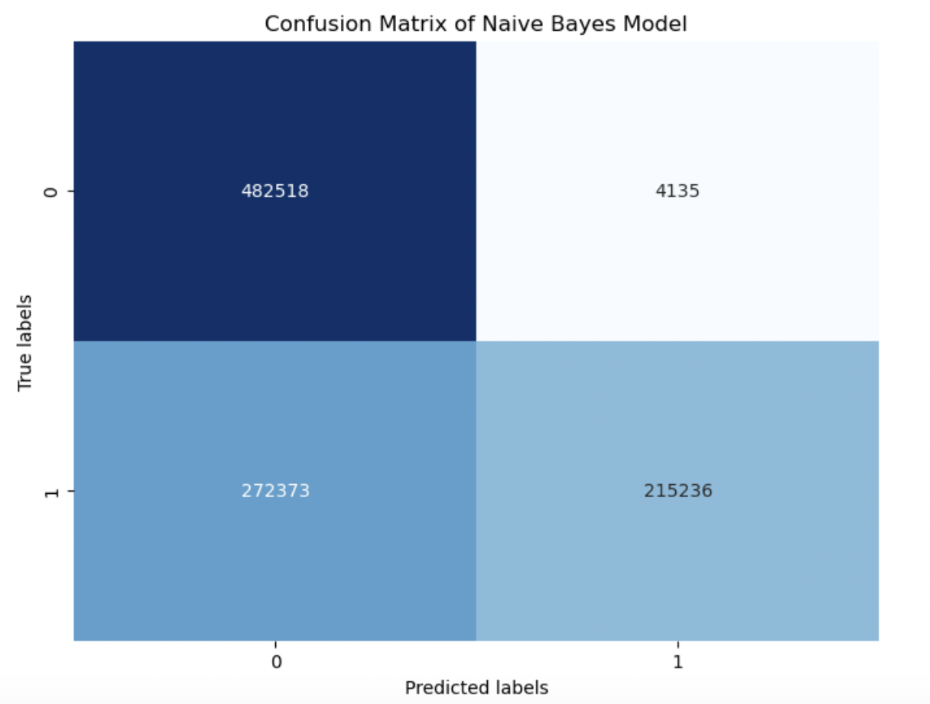
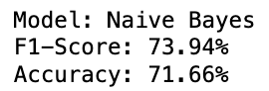
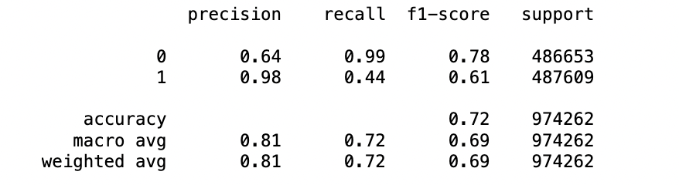
3.2 Naive Bayes
Low F1-score
struggles to achieve a balance between precision and recall
Possible Reasons
Violates NB’s assumption of feature independence
e.g. Transaction Amount and Merchant Category Code (MCC)
Not suitable for highly imbalanced datasets
# fraudulent transactions is much lower than # non-fraudulent transactions
a bias towards the class 0 and lower recall for class 1

Slide 14
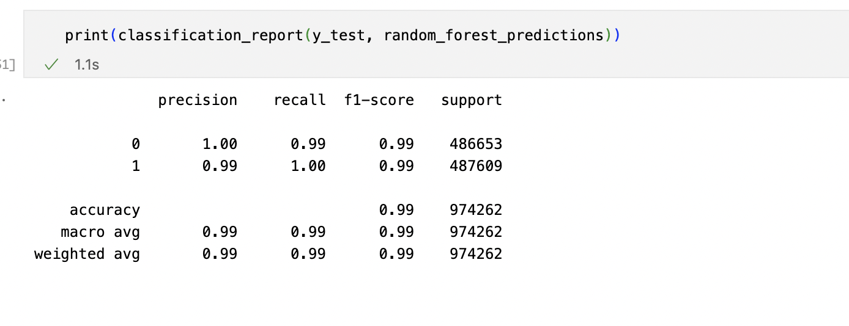
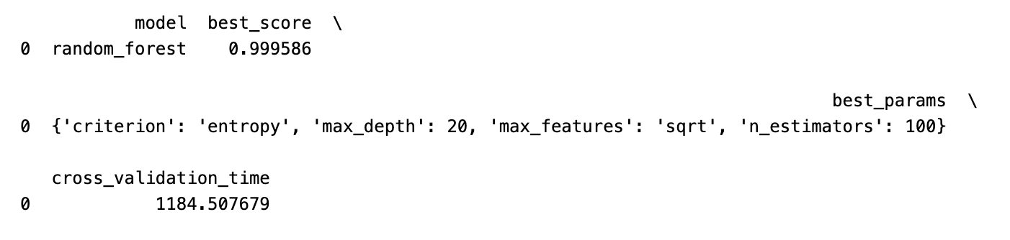
3.3 Random Forest - Hyperparameter Tuning
Model Parameters:
n_estimators： the number of estimators
max_depth： the maximum depth of the trees
criterion： the function to measure the quality of a split
max_features： the number of features to consider when looking for the best split
n_estimators： [100, 200]
max_depth: [10, 20]
criterion: [‘gini’, ‘entropy’]
max_features: [‘auto’, ‘sqrt’]
GridSearch CV Setup
3-fold cross-validation
Notes:
The process of finding the best set of hyperparameters for a RandomForestClassifier using cross-validation.
The purpose of using GridSearchCV is to evaluate different combinations of hyperparameter values to find the best combination that maximizes the recall score of the model.
Initialize GridSearchCV with the parameters from the mp dictionary, setting cv=3 for 3-fold cross-validation,
Perform the fit on the training data, which runs the grid search.

Slide 15
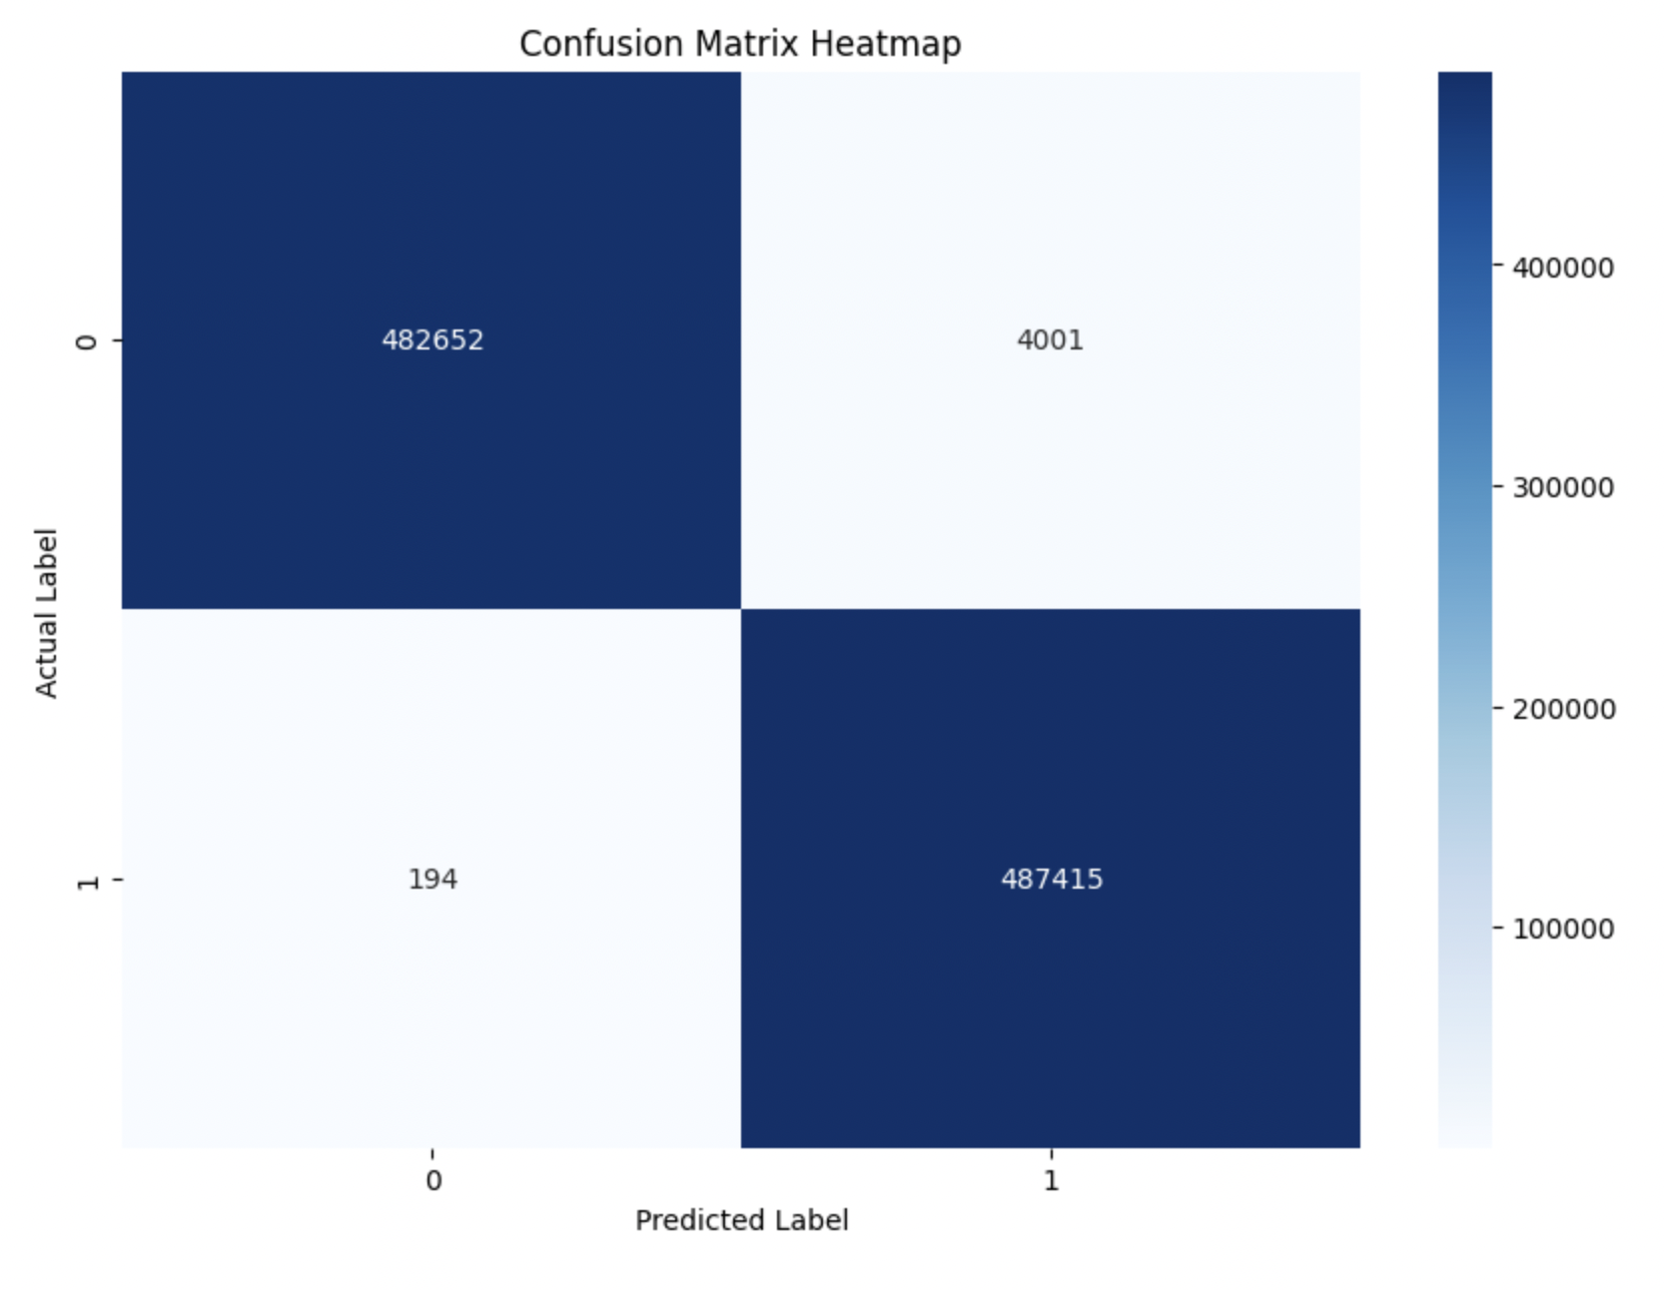
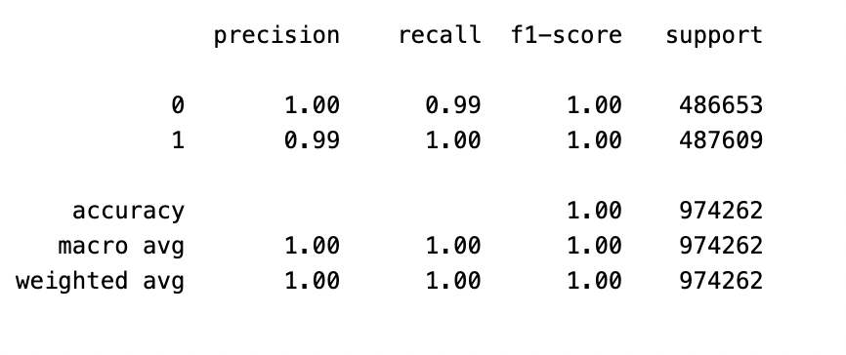
3.3 Random Forest
Pros:
Nearly perfect(High precision, recall, f1-score)
An almost ideal performance of the classifier
Cons:
Raise concerns about overfitting
Need to spend more time training

Slide 16
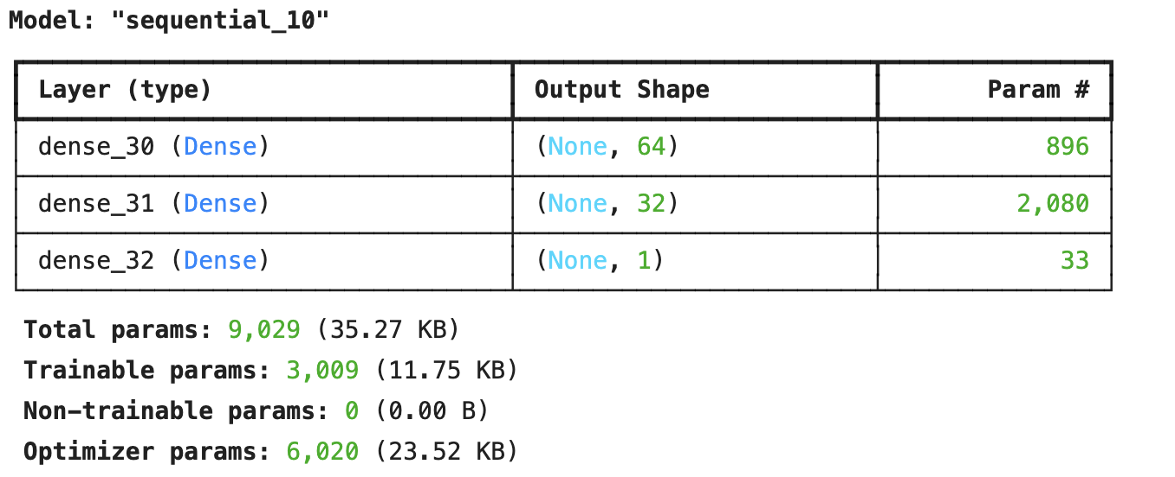
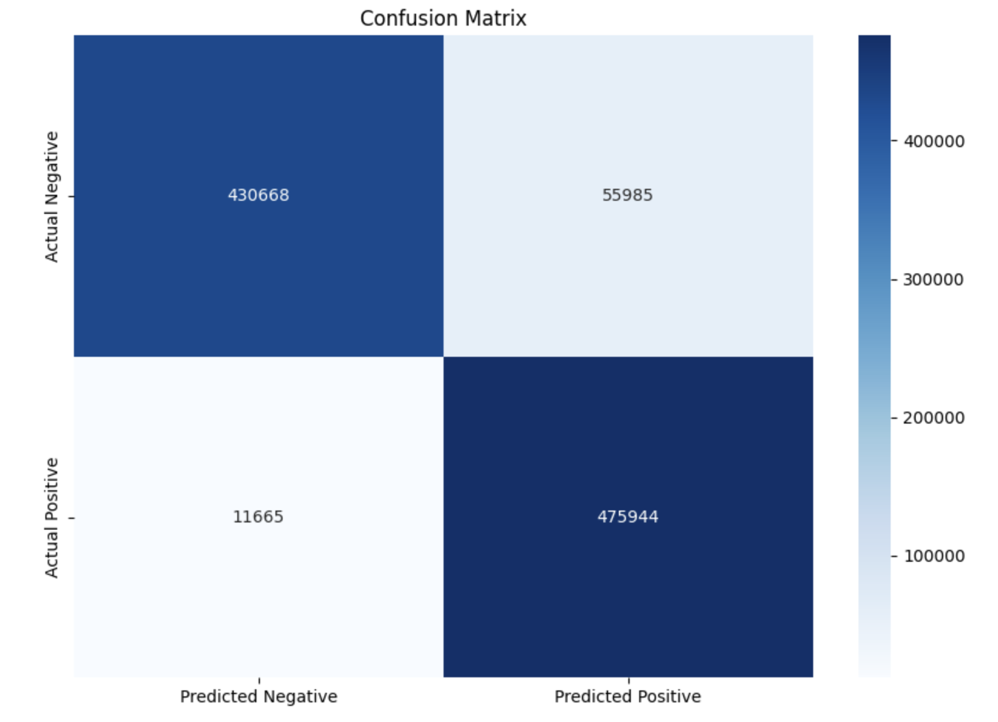
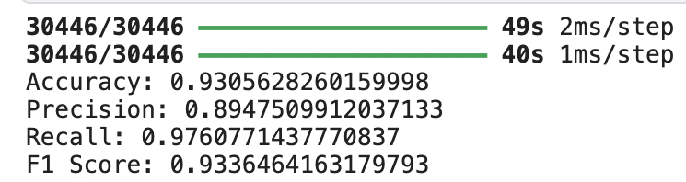
3.4 Neural Network
Model Parameters:
3 Layers neural network
ReLU and sigmoid activations
Adam optimizer
Binary cross entropy loss function
10 epochs and 128 bach size
Kaggle GPU

Slide 17
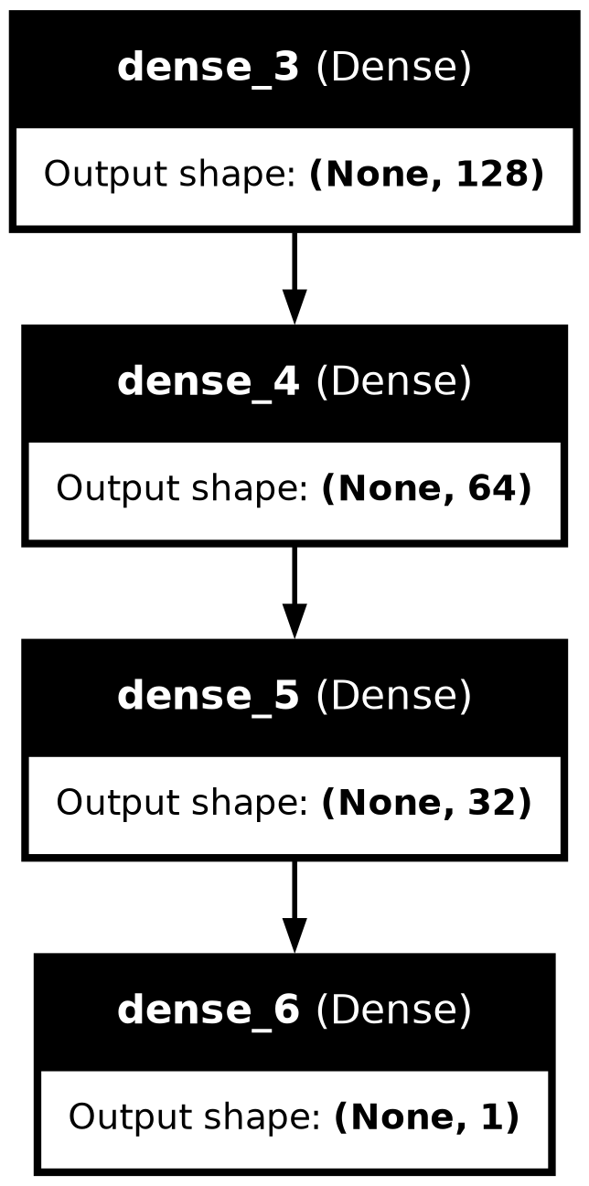
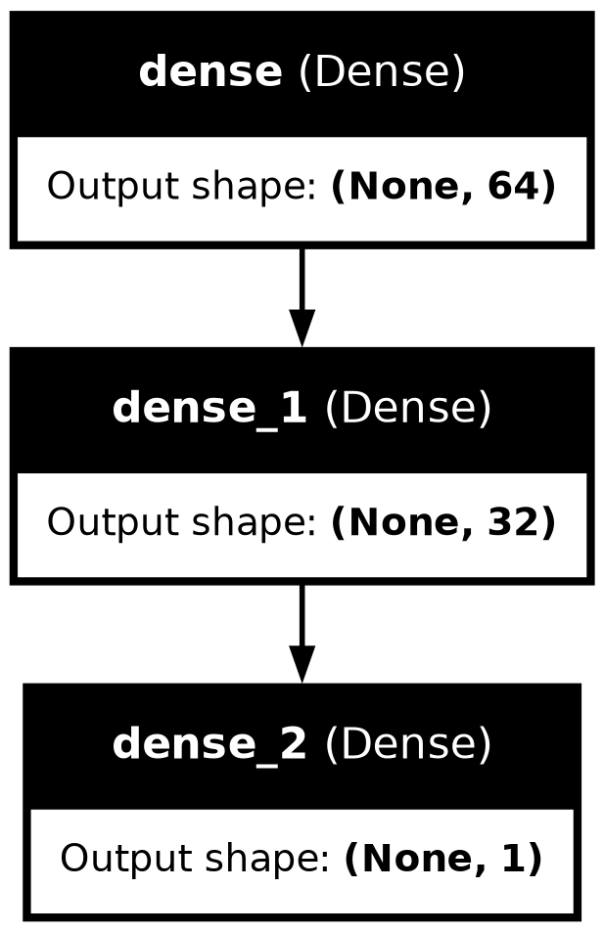
3.4 NN Model Comparison
Model Comparison:
Add layers
10 Epochs vs. 50 Epochs
Result:
More complex models are not always better
Model 1 initially has a better precision-recall balance
Model 1 at 50 epochs shows the model is trending towards overfitting
Model Description | Epochs | Layers | Accuracy | F1 Score | Loss | Training Time/Epoch
Model 1 (Initial) | 10 | 3 | 0.9346 | 0.9367 | 0.1836 | ~40s
Model 1 (Extended) | 50 | 3 | 0.9314 | 0.9349 | 0.1919 | ~43s
Model 2 | 10 | 4 | 0.9263 | 0.9292 | 0.2185 | ~46s

Slide 18

4. Result
Accuracy & ROC Comparison

Slide 19

4.1 Results: Accuracy Comparison
 | Accuracy | Precision | Recall | F1 Score | Training Time
Naive Bayes | 0.72 | 0.81 | 0.72 | 0.74 | 2.36 secs
Logistic Regression | 0.92 | 0.92 | 0.92 | 0.92 | 42 secs
Random Forest | 0.99 | 0.99 | 0.99 | 0.99 | 19.44 mins
Neural Network | 0.93 | 0.89 | 0.98 | 0.93 | 40 secs per epoch
Random Forest achieved the highest F1 score but longer training time
Logistic Regression and Neural Network also performed well
high accuracy and balanced precision and recall scores

Slide 20
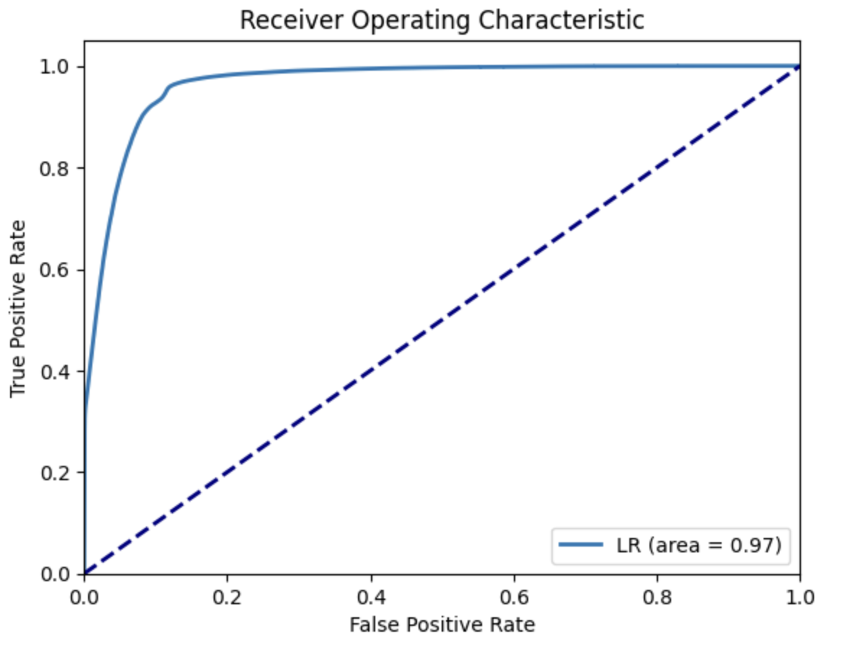
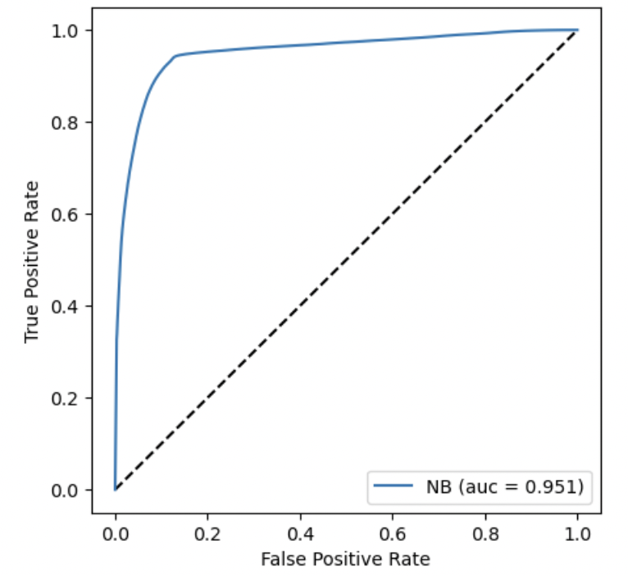
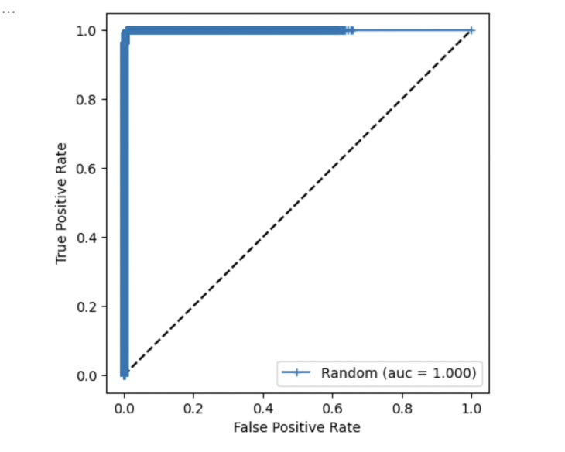
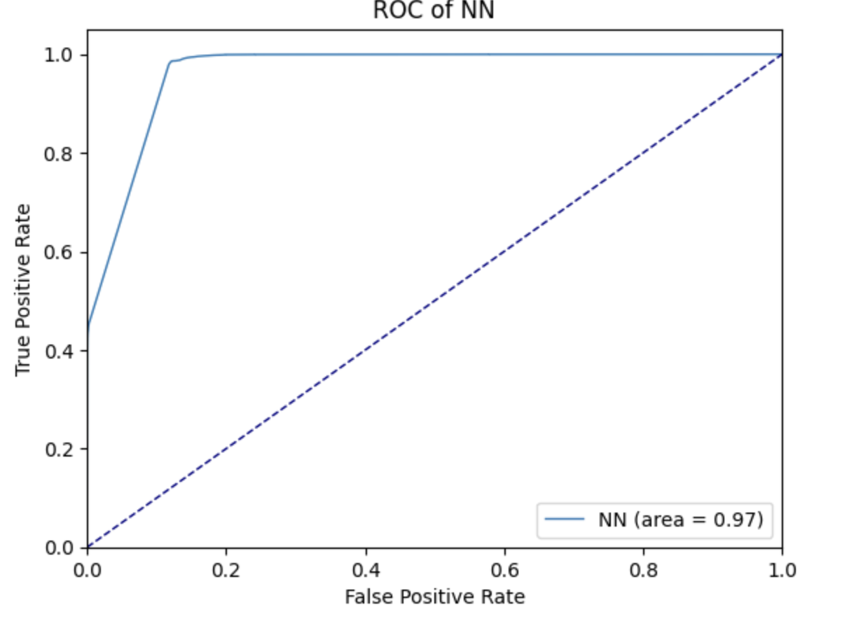
4.2 Results: ROC Comparison
 | AUC
Logistic Regression | 0.97
Naive Bayes | 0.95
Random Forest | 1
Neural Network | 0.97
Random Forest
a perfect AUC score of 1
excellent performance in the classification
Logistic Regression and Neural Network
AUC scores close to 1

Slide 21
5.Recommendation
Conclusion

Slide 22
5. Recommendation & Conclusion
With all the tested models (Logistic Regression, Naive Bayes, Random Forest, and Neural Network), the best results were seen with Random Forest Classifiers with an accuracy of nearly 100% and with high precision, recall, and f1-score.
Need a fast model and can compromise on accuracy
Naive Bayes
Look for a balance between speed and performance, interpretability
Logistic Regression
Performance is the most important and training time is not a constraint
Random Forest
Requires a high recall (minimizing false negatives)
Neural Network
Notes:
How can we effectively build and evaluate machine learning models to detect fraudulent transactions in credit card data?

Slide 23

Thank you!

Slide 24
Do you have any questions?
We hope you learned something new.

